Slide 1
Classifying Gait Data using different machine learning techniques and finding the optimum technique of classification
Presented by
ANUBHA PARASHAR
Computer Science and Engineering
MAHARSHI DAYANAND UNIVERSITY, ROHTAK.

Slide 2
Outline
GAIT/ Human GAIT
AIM
Proposed work and Methodology
Data Collection & Demos
Conclusion
Result analysis
Classification of gait data using KNN, SVM, ANN(Back Propagation), Classifier fusion
Problem Statement
Proposed Solution

Slide 3
What is GAIT?
Gait
Gait refers to the manner in which a person walks, and is one of the few biometric traits that can be used to recognize people at a distance.
Therefore, this trait is very appropriate in surveillance scenarios and gait recognition system.

Slide 4
Human gait
Human gait analysis refers to the study of human locomotion.
Applications are in a large variety of domains, including entertainment, healthcare and pedestrian navigation.
The act of walking involves the coordination of different human body parts, such as the skeleton, the muscle and the neural systems.
Various factors can affect the complex interaction between the body parts, for example any pathological nature will require a distinction between ― normal gait and pathological gait.
Normal gait refers to the naturalistic and general human walking parameters without differentiating the age, sex or individual physical parameters.
Conversely, ―pathological gait‖ refers to an abnormal gait, for example affected by pathologies such as muscle weakness or skeleton deformities.

Slide 5
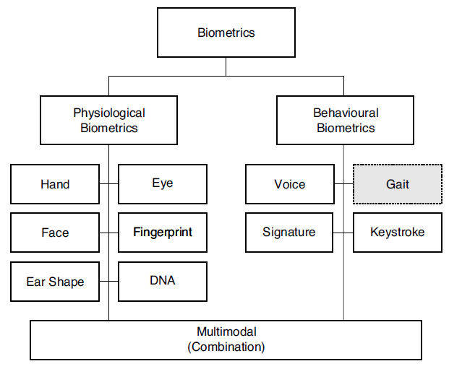
Problem Statement
To verify/validate the identity of people is called as authentication.
And now a day’s authentication is becoming very popular to check whether a person is authentic or not.
Previously authentication was done with secret passwords or PIN codes. The disadvantage of such authentication systems was anyone could crack the password or PIN codes.
So, biometric (in fig.) technology came to existence where authentication is done using a particular body part like fingers, iris etc. But now a days these biometrics are not user friendly as people dislike accessing finger print machine or avoid iris scanner as it may weaken or damage their vision.

Slide 6
Proposed Solution
Identifying normal or pathological human gait poses many challenges. Therefore a robust method for detecting and capturing the body, face and/or gait of each individual person has to be found.
Human gait is supposed as unique biometric identification like thumb print. So in GAIT analysis to examine the human walking moment we collect and analyze the data. Human gait can be utilized to identify people for diverse security reason and exercised before to detect many abnormalities.
The GAIT data can be useful to help in walking of old people and is used in pattern analysis and classification of different walk.

Slide 7
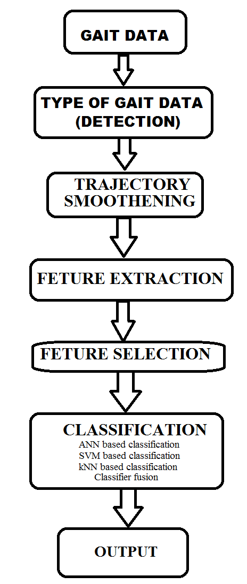
Proposed Solution
We have developed the computational model for prediction, formal verification and analyses of bipedal locomotion using machine learning technique for modelling.

Slide 8

AIM
The aim of this paper is to evaluate and implement a sufficiently robust and accurate method for human to identify whether it’s a normal gait or pathological gait and to improve the speed and accuracy of classification in the presence of category hierarchies.

Slide 9
Methodology
Monday, May 11, 2026

Slide 10
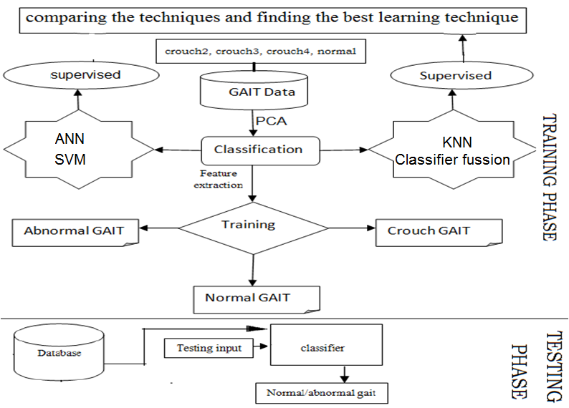
Proposed Work

Slide 11
Methodology
Firstly we collect the GAIT data then features are extracted and we classify the GAIT dataset.
Training and testing of system is done.
After the classification is done result is shown as normal or pathological GAIT.
Then 10 fold cross-validation test is also conducted to validate the statistical significance of the results.

Slide 12
Data Collection
HMCD
To capture the human data we use HMCD. From this device different joint angles (knee, hip, and ankle) are captured to get the human GAIT data.

Slide 13
Empirical Study of Gait by HMCD

Slide 14
Analysis of dataset
When the dataset is simulated, then the coordinates of the human GAIT data set is captured and shown in figure for crouch2, crouch3, crouch4, normal datasets respectively.

Slide 15
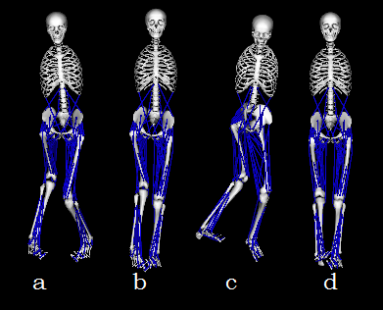
Simulation of dataset in openSim

Slide 16
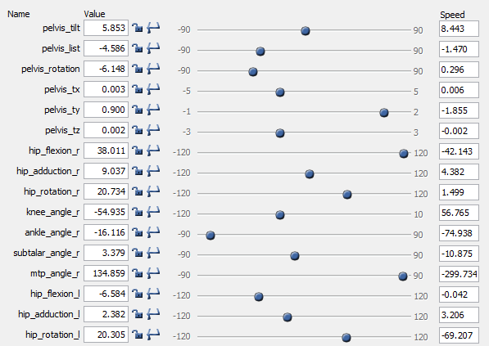
Values of crouch2 dataset

Slide 17
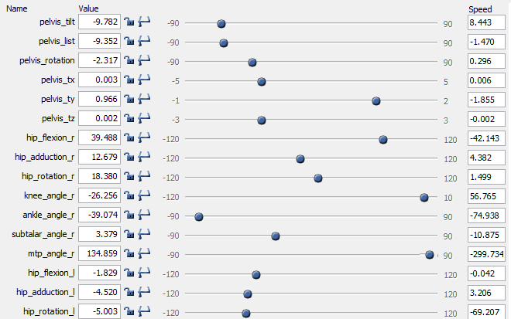
Values of crouch3 dataset

Slide 18
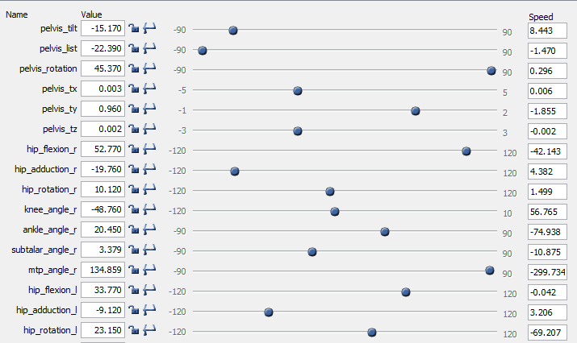
Values of crouch4 dataset

Slide 19
Values of normal dataset

Slide 20
Feature Selection
Feature Category | Feature Name
F1 | Pelvis_tilt
F2 | Pelvis_list
F3 | Pelvis_rotation
F4 | Pelvis_tx
F5 | Pelvis_ty
F6 | Pelvis_tz
F7 | hip_flexion_r
F8 | hip_adduction_r
F9 | hip_rotation_r
F10 | knee_angle_r
F11 | ankle_angle_r
F12 | ankle_angle_l
F13 | knee_angle_l
F14 | hip_flexion_l
F15 | hip_adduction_l
F16 | hip_rotation_l

Slide 21
Classification
KNN, ANN, SVM, fusion classifier

Slide 22
Classification
Classification is a collection of different methods for categorizing data.
To correctly classify the data one wishes to find features that separate each group of data into clusters.

Slide 23
Classification
Classification of GAIT data is done through two following techniques:
KNN
ANN
SVM
Classifier fusion

Slide 24
Artificial Neural Network (Back Propagation)
Back propagation, an abbreviation for "backward propagation of errors", is a common method of training artificial neural networks.

Slide 25
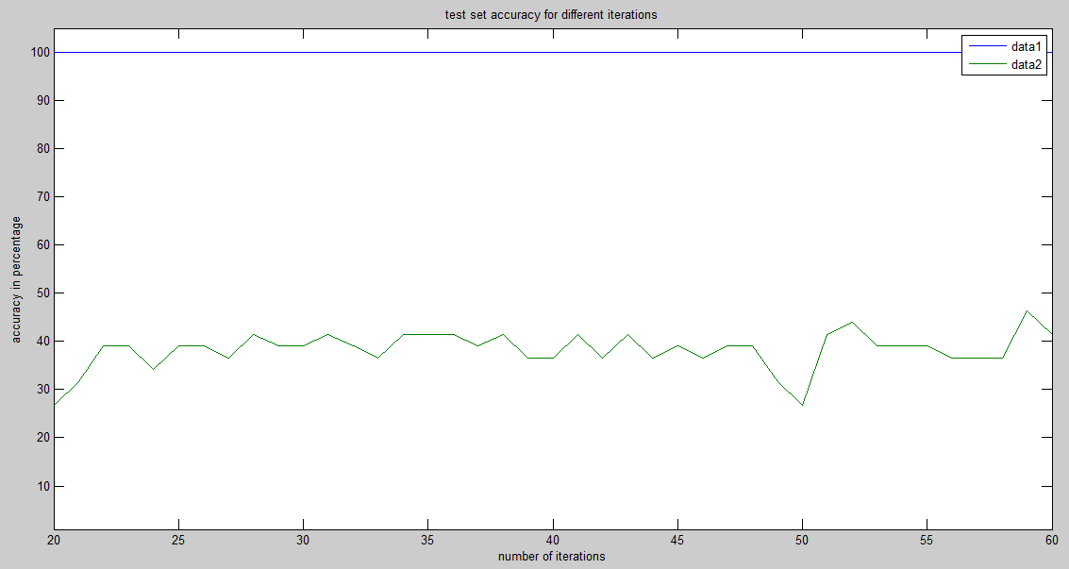
Result

Slide 26
Result
Exp. No | Iterations | Training accuracy (%) | Test accuracy (%)
1 | 100 | 84 | 80
 | 500 | 86 | 80
2 | 100 | 86 | 80
 | 500 | 90 | 82
3 | 100 | 86 | 82

Slide 27
KNN
K-Nearest Neighbours algorithm (or k-NN for short) is a non-parametric method used for classification. In this, the input consists of the k closest training examples in the feature space. The output depends on whether k-NN is used for classification:
In k-NN classification, the output is a class membership. An object is classified by a majority vote of its neighbours, with the object being assigned to the class most common among its k nearest neighbours (k is a positive integer, typically small). If k = 1, then the object is simply assigned to the class of that single nearest neighbour.

Slide 28
KNN Result

Slide 29
KNN Result
Exp No. | K | Training accuracy (%) | Testing accuracy (%)
1 | 3 | 74 | 70
2 | 5 | 79 | 80
3 | 7 | 78 | 74
4 | 9 | 84 | 81

Slide 30
SVM
In machine learning, support vector machines are supervised learning models with associated learning algorithms that analyze data used for classification. Given a set of training examples, each marked for belonging to one of two categories, an SVM training algorithm builds a model that assigns new examples into one category or the other, .

Slide 31
Result
Exp No. | Function Kernel | Training accuracy(%) | Test accuracy (%)
1. | Linear function | 68 | 71
2. | Quadratic function | 70 | 76
3. | Polynomial function | 84 | 84
4. | Radial Basis Function | 88 | 84

Slide 32
Classifier Fusion
Classifier fusion combines many classifiers and provides the result by combining the results of the individual classifiers.
In this paper, we have combined the results of ANN, SVM and KNN models to achieve the classifier fusion result.
Thus, the performance of classifier fusion is likely superior than the individual classifiers used in isolation.

Slide 33
Result
Expt# | ANN classifier Accuracy (%) | SVM classifier Accuracy (%) | kNN with k=5 Accuracy (%) | Classifier fusion Accuracy (%)
1 | 89.67 | 91.62 | 80.76 | 89.67
2 | 92.91 | 91.92 | 78.89 | 90.75
3 | 87.82 | 88.52 | 91.82 | 87.82
4 | 93.60 | 85.60 | 90.40 | 89.60
5 | 91.01 | 89.21 | 92.21 | 86.75

Slide 34
Comparison of success rate by different classifier using 5–fold cross validation
Classifier | Rate of Success (%)
ANN | 82.58
SVM | 80.11
KNN | 87.72
Classifier fusion | 93.56

Slide 35
Conclusions
It was noted that from all the other individual classifiers for various feature set performed the performance of the classifier fusion is best. Therefore we get the highest overall accuracy of 93.56% by using the combination of optimal features and classifier fusion as compared to other feature and classifier combinations.

Slide 36
Conclusion
The proposed system can be used for developing a gesture controlled hexadecimal keyboard making human-computer interaction easier.
The results of the three individual classifiers were combining to provide the classifier fusion results.
After this, 5-fold cross validation was used to provide overall accuracy of the system.
Overall accuracy was observed to be 82.58, 8.11%, 87.72% and 93.56% using the ANN, SVM, KNN and classifier fusion respectively.

Slide 37
Questions?

Slide 38
Thank you
Have a great day ahead

